Slide 1
A* Search Algorithm

Slide 2
What is A* search algorithm

Slide 3
Its a popular and efficient search algorithm used for finding the shortest path between two nodes in a graph. It combines the advantages of both uniform cost search and greedy best-first search.
A* search algorithm finds the shortest path through the search space using the heuristic function. This search algorithm expands less search tree and provides optimal result faster. A* algorithm is similar to UCS except that it uses g(n)+h(n) instead of g(n).

Slide 4
The A* algorithm evaluates nodes in the graph based on two key pieces of information:
G-cost (or path cost): This represents the cost of getting from the start node to a particular node along the current path. It is the sum of the costs of all the edges traversed so far.
H-cost (or heuristic cost): This is an estimate of the cost from a particular node to the goal node. It is often calculated using a heuristic function that provides an optimistic estimate of the remaining distance. The choice of heuristic greatly affects the algorithm's performance.

Slide 5
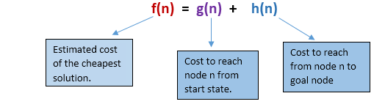
We can combine both costs as following, and this sum is called as a fitness number.

Slide 6
Fitness number
Refers to the combined cost of a node, which includes both the actual path cost and the heuristic cost. It serves as a measure of desirability or priority for expanding a particular node during the search process.

Slide 7
How it incorporates elements from UCS and BFS

Slide 8
Just a Recap
Uniform Cost Search (UCS): UCS is a search algorithm that explores the graph by considering the cost of each path. It expands the node with the lowest path cost, ensuring that the shortest path is always found. A* builds upon this idea by using the G-cost component of the algorithm
Best-First Search: Best-First Search is a search algorithm that prioritizes nodes based on a heuristic function. It selects the node that appears to be closest to the goal, based on the estimated cost. In A*, the heuristic function is incorporated into the H-cost component.

Slide 9
A* combines these two approaches
A* combines these two approaches by using the G-cost (UCS) to keep track of the cost incurred so far to reach a particular node, and the H-cost (BFS) as an estimate of the remaining cost from that node to the goal. The sum of the G-cost and H-cost, referred to as the F-cost (F = G + H), represents the total estimated cost of the path..

Slide 10
What is heuristic cost in A* search
It is an estimated cost or distance from a node to the goal node. It provides an informed estimate of the remaining cost required to reach the goal from a specific node in the search space.
The heuristic cost serves as a guide for the algorithm, giving it an approximation of how far a node is from the goal. By using this estimation, A* can prioritize nodes that are closer to the goal, leading to a more efficient search.

Slide 11
Recap: How to calculate heuristic
Manhattan Distance: This heuristic is often used in grid-based pathfinding problems, where movement is restricted to horizontal and vertical directions. The Manhattan distance between two points is the sum of the absolute differences of their x and y coordinates. In a grid, it can be calculated as the number of horizontal and vertical steps required to reach the goal from the current node, ignoring any obstacles or diagonal movements.

Slide 12
Euclidean Distance: The Euclidean distance is a commonly used heuristic for continuous space or grid-based problems where diagonal movement is allowed. It represents the straight-line distance between two points in Euclidean geometry.
And many more……………

Slide 13
Python/JavaScript implementation

Slide 14
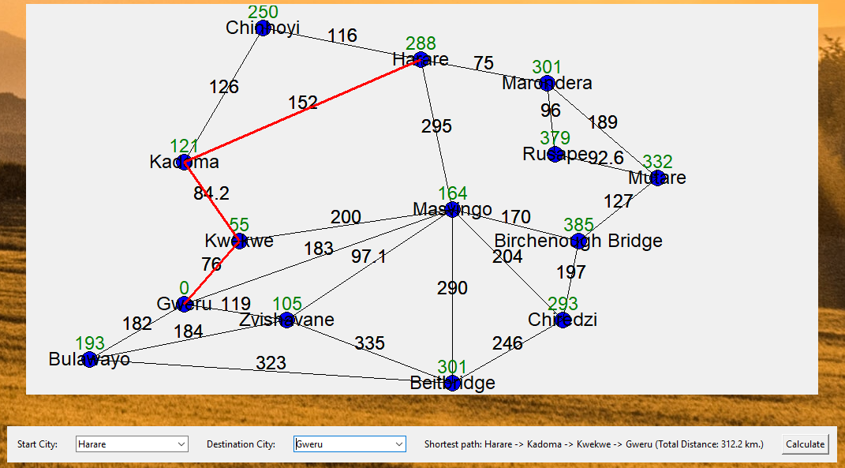

Slide 15
OList ={ }
Kw(311,2)
,C(366),
C(376),
M(580.20)
ClosedList = { }
K(293)
H(288)
G(332.2)
Mr=(376),
M(459),
,
,
,
H
116
172
295
75
F(n) = 116+250
=366
F(n) = 172+121
=293
F(n) = 295+164
=459
F(n) = 75+301
=376
C
K
M
Mr
126
84.2
F(n) = 142+126+250
=376
C
F(n) = 172+84.2+55
=311.2
Kw
State | Key | h(n)
Harare | H | 288
Chinhoyi | C | 250
Marondera | Mr | 301
Kadoma | K | 121
Masvingo | M | 164
Kwekwe | Kw | 55
Gweru | G | 0
200
76
F(n) = 142+74.2+200+164
=580.2
M
F(n) = 172+84.2+76+0
=332.2
G

Slide 16
OList ={ }
ClosedList = { H(288),K(293),Kw(311.2),G(332.2) }
C(366),
Mr=(376),
M(459)
H
116
172
295
75
F(n) = 116+250
=366
F(n) = 172+121
=293
F(n) = 295+164
=459
F(n) = 75+301
=376
C
K
M
Mr
126
84.2
F(n) = 142+126+250
=376
C
F(n) = 172+84.2+55
=311.2
Kw
State | Key | h(n)
Harare | H | 288
Chinhoyi | C | 250
Marondera | Mr | 301
Kadoma | K | 121
Masvingo | M | 164
Kwekwe | Kw | 55
Gweru | G | 0
200
76
F(n) = 142+74.2+200+164
=580.2
M
F(n) = 172+84.2+76+0
=332.2
G

Slide 17
A* algorithm
1. Create an open list and a closed list that are both empty. Put the start node in the open list.
2. Loop this until the goal is found or the open list is empty:
a. Find the node with the lowest F cost in the open list and place it in the closed list.
b. Expand this node and for the adjacent nodes to this node:
i. If they are on the closed list, ignore.
ii. If not on the open list, add to open list, store the current node as the parent for this adjacent node, and calculate the F,G, H costs of the adjacent node.
iii. If on the open list, compare the G costs of this path to the node and the old path to the node. If the G cost of using the current node to get to the node is the lower cost, change the parent node of the adjacent node to the current node. Recalculate F,G,H costs of the node.
3. If open list is empty, fail.

Slide 18
A* algorithm completeness and optimality conditions

Slide 19
Completeness
The A* algorithm is considered complete if the branching factor of the search space is finite, meaning that there is a finite number of possible actions or transitions from each node, and the cost associated with each action is fixed. In such cases, A* is guaranteed to find a solution if one exists. However, if the branching factor is infinite or the costs can vary, the algorithm may not terminate.

Slide 20
Optimality
A* can guarantee optimality under certain conditions. To achieve optimality, two conditions must be met:
1. Admissible heuristic: The heuristic function used in A* must be admissible. An admissible heuristic never overestimates the cost to reach the goal from any node. In other words, the estimated cost provided by the heuristic should always be less than or equal to the actual cost. If the heuristic is admissible, A* is guaranteed to find the least cost path to the goal.

Slide 21
2. Consistency (or the triangle inequality): The heuristic function must also satisfy the consistency condition, also known as the triangle inequality. It states that the estimated cost from a node to its successor plus the estimated cost from the successor to the goal must be greater than or equal to the estimated cost from the current node to the goal. Mathematically, if h(n) represents the heuristic estimate for node n, and d(n, n') represents the cost from node n to its successor n', then the consistency condition can be expressed as h(n) ≤ d(n, n') + h(n').

Slide 22
Time and space complexity
The time and space complexities of the A* search algorithm are influenced by several factors, including the quality of the heuristic function and the depth of the solution

Slide 23
Time Complexity
The time complexity of A* is exponential in the worst case, specifically dependent on the depth of the solution. This means that as the depth of the solution increases, the time required to find the optimal path can grow exponentially.
O(b^d)
Where:
b is the branching factor (average number of successors for each node)
d is the maximum depth of the search space.

Slide 24
Space Complexity
The space complexity of A* is also exponential in the worst case and is related to the depth of the solution.
O(b^d)
Where:
b is the branching factor (average number of successors for each node)
d is the maximum depth of the search space.

Slide 25
Advantages
1. Completeness: A* is guaranteed to find a solution if one exists, given that the heuristic used is admissible (never overestimates the actual cost).
2. Optimality: A* guarantees to find the optimal solution, meaning the shortest path, as long as the heuristic is both admissible and consistent (or monotonic).

Slide 26
3. Efficiency: A* is typically more efficient than uninformed search algorithms like breadth-first search (BFS) or depth-first search (DFS) because it uses heuristics to guide its search and prioritize promising paths
4. Flexibility: A* allows the use of different heuristics based on the problem domain, making it adaptable to various types of optimization and pathfinding problems.
5. Wide Applicability: A* can be applied to a wide range of problems, including pathfinding, puzzle solving, robotics, network routing, and more, making it a versatile algorithm.

Slide 27
Disadvantages
1. Heuristic Dependency: The performance and efficiency of A* heavily rely on the quality of the heuristic used. A poor or inaccurate heuristic can lead to suboptimal solutions or increased runtime.
2. Memory Usage: A* may require substantial memory resources, especially for large or complex search spaces, as it needs to store and manage the open and closed lists.

Slide 28
3. Computational Cost: The computational cost of evaluating the heuristic function for each node can be significant, particularly if the heuristic is computationally expensive or the search space is vast.
4. Admissibility and Consistency Requirement: A* requires an admissible heuristic to guarantee optimality and a consistent heuristic for efficient search. Developing or finding such heuristics can be challenging in some problem domains.
5. Pathological Cases: In certain scenarios, such as when the heuristic is inconsistent or when there are loops or cycles in the search space, A* may encounter difficulties, including suboptimal solutions or getting stuck in infinite loops.

Slide 29
Applications of A* Search

Slide 30
Path finding: navigation systems, robotics, and video games
A* search can be used to find the shortest route between two locations on a map, or to find the shortest path for a robot to navigate through an environment. Google Maps uses A* search to find the fastest route between two locations
A* is commonly used in game development for tasks like enemy AI path finding, NPC movement, and terrain analysis. It allows characters or agents to navigate game worlds efficiently, considering obstacles, terrain costs, and other game-specific factors. Robotics and Autonomous Vehicles

Slide 31
Planning
scheduling and automated theorem proving. For example, A* search can be used to find a plan to achieve a goal from a given state, or to find a proof of a mathematical theorem
A* search is used in automated theorem proving to find proofs of mathematical theorems. For instance, Alpha Go, the AI program that defeated a human world champion at Go, uses A* search to evaluate possible moves. Used in scheduling to find optimal schedules for resources

Slide 32
Constraint satisfaction
used in constraint satisfaction problems, such as scheduling and routing. For example, A* search can be used to find a schedule that satisfies all of the constraints of a job, or to find a route that satisfies all of the constraints of a delivery.

Slide 33
Puzzle Solving
A* can be used to solve various types of puzzles, such as the sliding tile puzzle or the 8-queens puzzle. The algorithm explores the search space, evaluating the cost of reaching each state and using a heuristic to guide the search towards the goal state.

Slide 34
Maita basa……

